Slide 1
Azure ML Tutorial
- Azure Bootcamp in Troy -
2016. 4. 16
Ingyu Lee
(inlee@troy.edu)

Slide 2
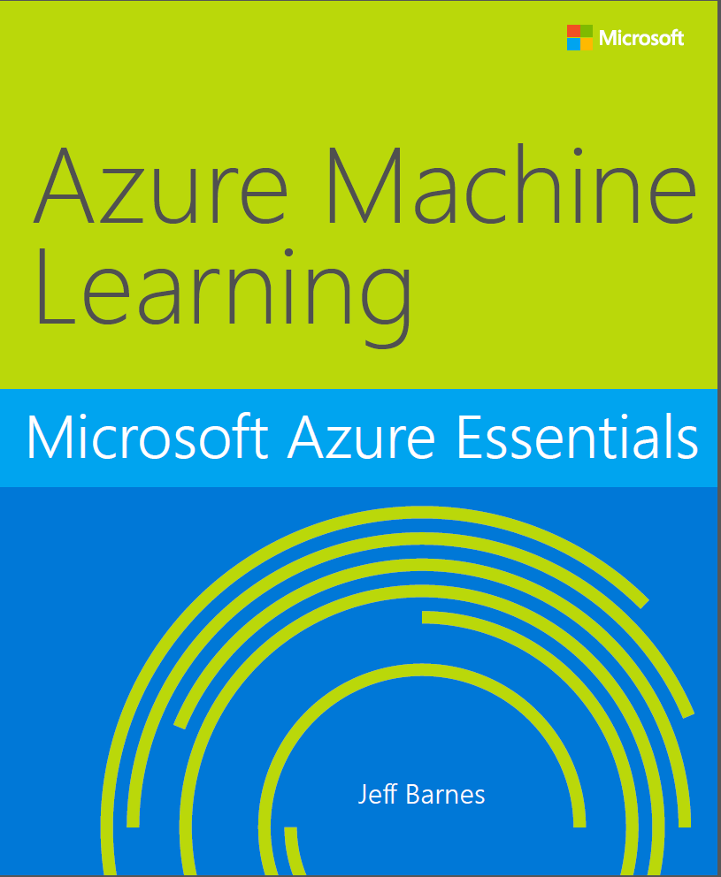
Contents
I Introduction
What is AzureML?
AzureML Workflow
AzureML Key Terminology and Concept
II The First Experiment of AzureML
Overview of AzureML
Create a Model
Build a Model
Test and Evaluate the model
Publish as a Web Service
III AzureML Hands-On
Classification
Cluster analytics
The Azure ML Matchbox recommender
Exercises
IV Lessons / Resources
Book, Microsoft Azure Essentials: Azure Machine Learning,
http://www.microsoftvirtualacademy.com/ebooks#9780735698178

Slide 3
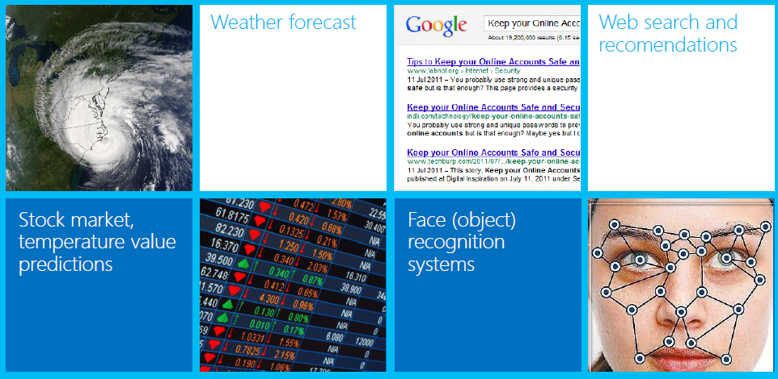
Part I What is Azure ML(Machine Learning)?
1. What is machine learning?
Machine learning uses computers to run predictive models that learn from existing data in order to forecast future behaviors, outcomes, and trends.
These forecasts or predictions from machine learning can make apps and devices smarter.
When you shop online, machine learning helps recommend other products you might like based on what you’ve purchased.
When your credit card is swiped, machine learning compares the transaction to a database of transactions and helps the bank do fraud detection.

Slide 4
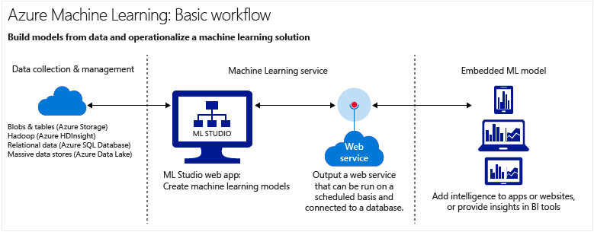
Part I What is Azure ML(Machine Learning)?
2. What is Machine Learning on Microsoft Azure?
Azure Machine Learning is a cloud-based predictive analytics service that makes it possible to quickly build and deploy predictive models as analytic solutions.
Azure Machine Learning not only provides tools to model predictive analytics, but also provides a fully-managed service you can use to deploy your predictive models as ready-to-consume web services.
Azure Machine Learning provides tools for creating complete predictive analytics solutions in the cloud: Quickly create, test, operationalize, and manage predictive models.

Slide 5
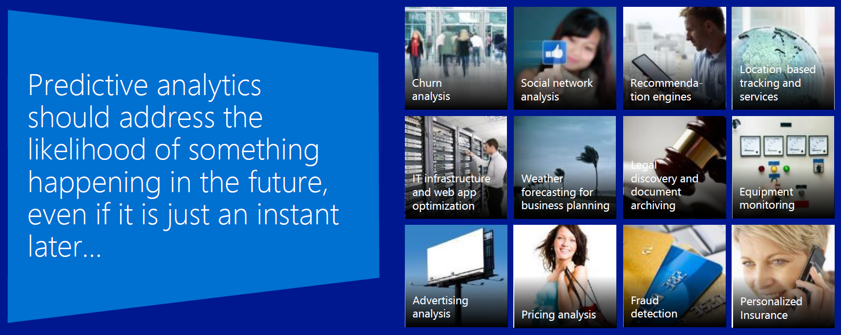
Part I What is Azure ML(Machine Learning)?
3. What is predictive analytics?
Predictive analytics uses various statistical techniques – in this case, machine learning – to analyze collected or current data for patterns or trends in order to forecast future events.
Azure Machine Learning is a particularly powerful way to do predictive analytics:
You can work from a ready-to-use library of algorithms, create models on an internet-connected PC without purchasing additional equipment or infrastructure, and deploy your predictive solution quickly.
You can also find ready-to-use examples and solutions in the Microsoft Azure Marketplace or Cortana Intelligence Gallery.

Slide 6
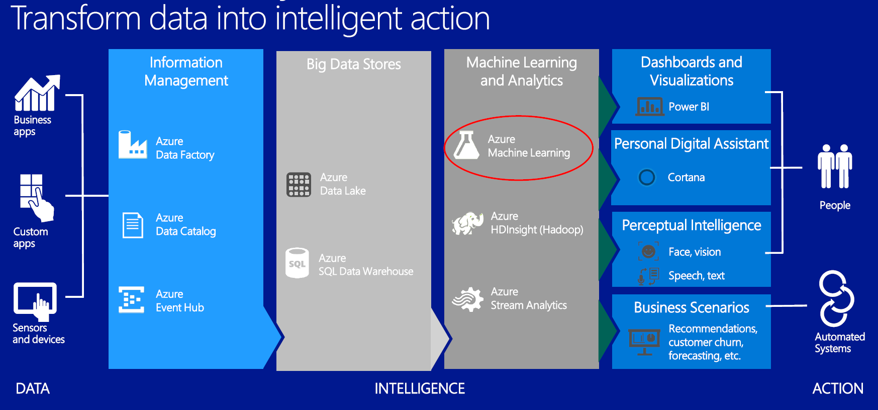
Part I Cortana Analytics Suite

Slide 7


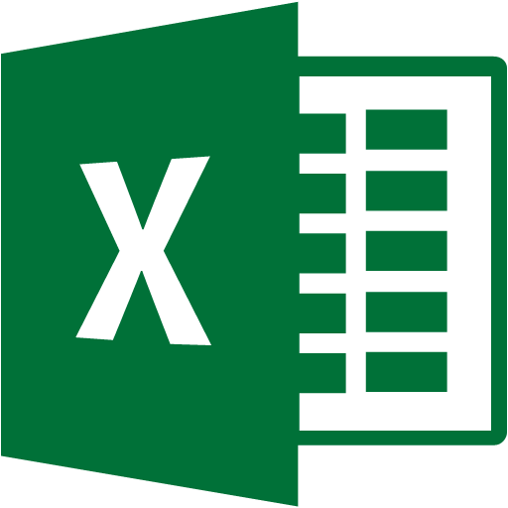



Part I Azure ML Workflow
Data
Azure Machine Learning
Consumers
Data
Model
ML Web Services
(REST API Services)
API
ML Studio
(Web IDE)
Cloud storage
Azure Storage
Azure Table
Hive
etc.
Excel
Manage
Workspace:
Experiments
Datasets
Trained models
Notebooks
Access settings
Azure Marketplace
(Applications store)
API
Local storage
Upload data from PC…
Azure ML Gallery
(community)
Business Apps
Business problem
Modeling
Deployment
Business value
Reference: TechEd 2014
Conference

Slide 8
Part I Key Machine Learning Terminology and Concepts
Data exploration:
Process of gathering information about a large and often unstructured data set in order to find characteristics for focused analysis. Data mining refers to automated data exploration.
Descriptive analytics:
Process of analyzing a data set in order to summarize what happened. The vast majority of business analytics – such as sales reports, web metrics, and social network analysis – are descriptive.
Predictive analytics:
Process of building models from historical or current data in order to forecast future outcomes.
Supervised learning:
Algorithms are trained with labeled data – in other words, data comprised of examples of the answers wanted. For instance, a model that identifies fraudulent credit card use would be trained from a data set in which data points indicating known fraudulent and valid charges were labeled.
Unsupervised learning:
Is used on data with no labels, and the goal is to find relationships in the data. For instance, you might want to find groupings of customer demographics with similar buying habits.

Slide 9
Part I Key Machine Learning Terminology and Concepts
Machine learning model
Abstraction of the question you are trying to answer or the outcome you want to predict. Models are trained and evaluated from existing data.
Training from data
In Azure Machine Learning, a model is built from an algorithm module that processes training data and functional modules, such as a scoring module.
In supervised learning, if you’re training a fraud detection model, you’ll use a set of transactions that are labeled as either fraudulent or valid. You’ll split your data at randomly, and use part to train the model and part to test or evaluate the model.
Evaluation data
Once you have a trained model, evaluate the model using the remaining test data. You use data you already know the outcomes for, so that you can tell whether your model predicts accurately.

Slide 10
Part I Key Machine Learning Terminology and Concepts
Classification:
Organizing data points into categories based on a data set for which category groupings are already known.
Regression:
Predicting a continuous value based on independent variables, such as predicting the price of a car based on its year and make.
Clustering:
Partition items into homogeneous groups. Typically used to predict grouping classifications for a given variable.
Recommendation:
The Netflix contest: Build a better recommender system from Netflix data. Use the crowd’s votes to complete the missing entries.
Anomaly Detection:
Forecast of a value or values from a machine learning model.
Occam’s Razor: The best models are simple models that fit the data well.
William of Ockham, English friar, philosopher, and theologian (1287-1347) said that among hypotheses that predict equally well, we should choose the one with the fewest assumptions.

Slide 11
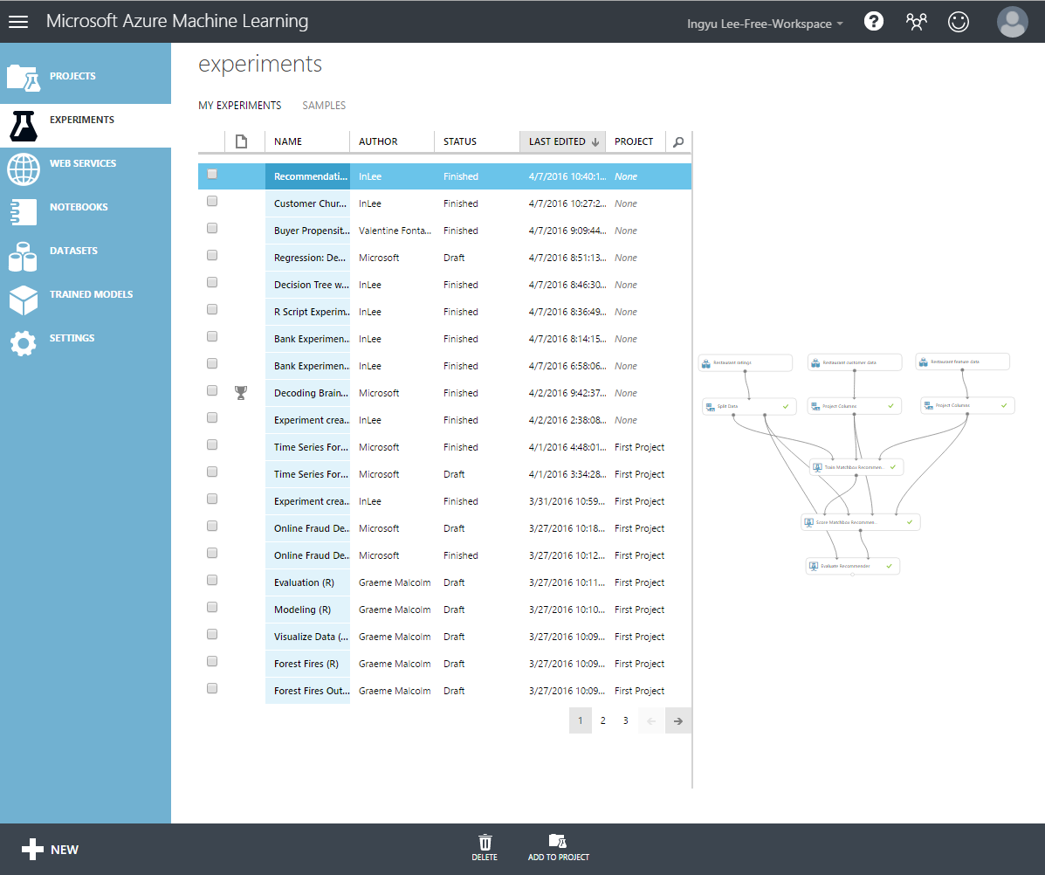
Part II Azure Machine Learning Studio
Projects: Sets of related Experiments, Trained Models, Datasets, Transforms.
Experiments: Experiments that have been created, run, and saved as drafts. These include a set of sample experiments that ship with the service to help jumpstart your projects.
Web Services: A list of experiments that you have published as web services.
Notebooks: Jupyter notebooks that you have created.
Datasets: A list of sample datasets that ship with the product, and uploaded data. You can use these datasets to learn about Azure Machine Learning.
Trained Models: List of any trained models that you saved from your experiments.
Settings: Configure your account and resources. Invite other users to share your workspace in Azure Machine Learning.

Slide 12
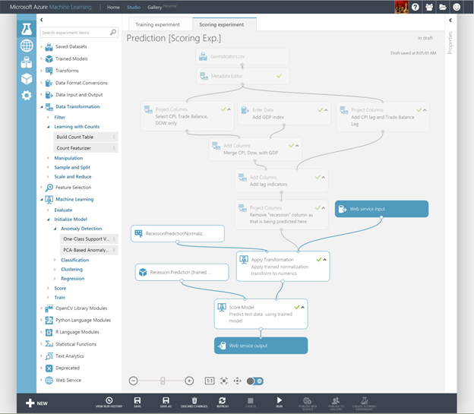
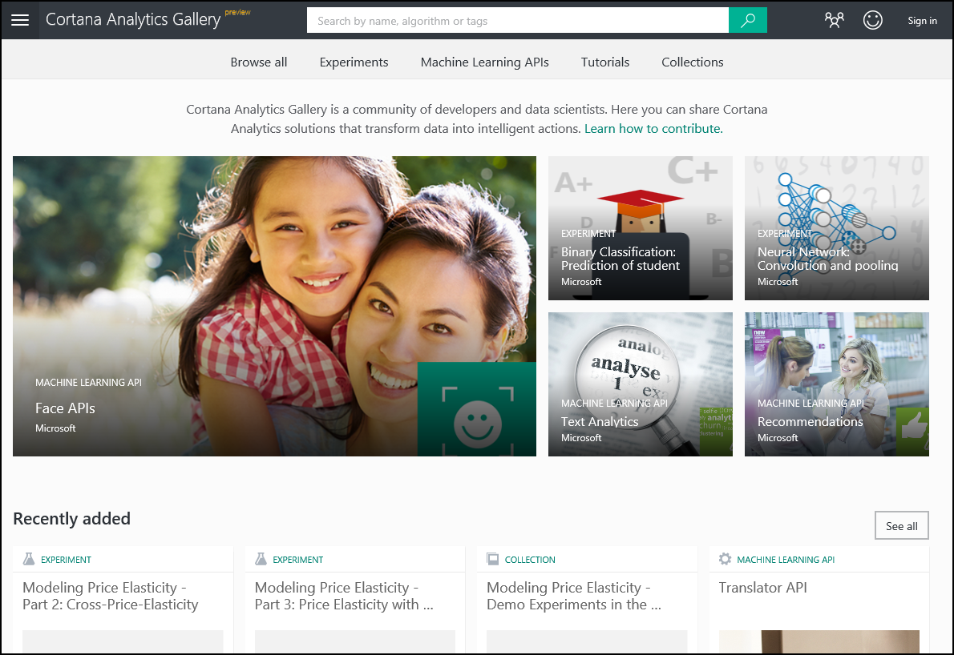
Part II Azure Machine Learning Studio
With Azure Machine Learning Studio, you can
Create predictive models in Machine Learning Studio, a browser-based tool, by dragging, dropping, and connecting modules.
Use a large library of Machine Learning algorithms and modules in Machine Learning Studio to jump-start your predictive models.
Choose from a library of sample experiments, R and Python packages, and best-in-class algorithms from Microsoft businesses like Xbox and Bing. Extent Studio modules with your own custom R and Python scripts.
In Cortana Intelligence Gallery you can try analytics solutions authored by others or contribute your own using Azure services including Machine Learning, HDInsight (Hadoop), Stream Analytics, and Data Lake Analytics, as well as Azure big data stores and data management services.

Slide 13




Part II First Experiment with Azure ML
Goal
Create a linear regression model that predicts the price of an automobile based on different variables such as make and technical specifications.
Steps
Create a model
Step 1: Get data
Step 2: Preprocess data
Step 3: Define features
Train the model
Step 4: Choose and apply a learning algorithm
Score and test the model
Step 5: Predict new automobile prices
1
De/Refine
business
problem
5
Monitor
model’s
performance
2
Extract data
1
Define
Target /
Metric
5
Evaluate Model
2
Extract
Derived
Features
4
Deploy model
3
Develop
model
through
iterations
4
Fit Model
3
Select
Features

Slide 14
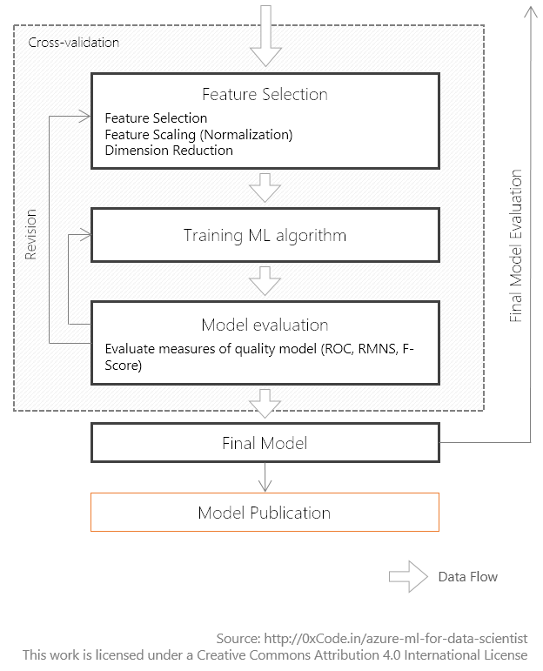
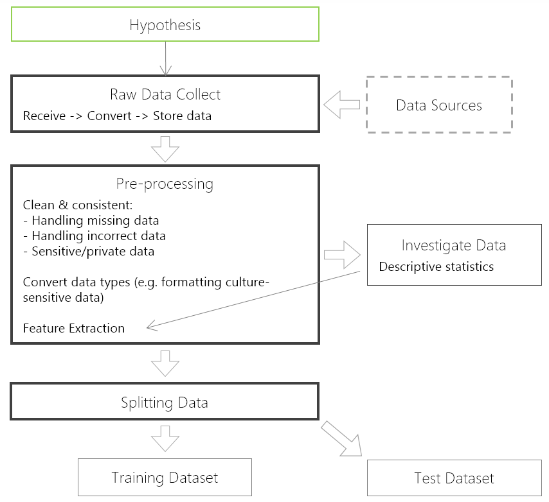
Part II First Experiment with Azure ML

Slide 15
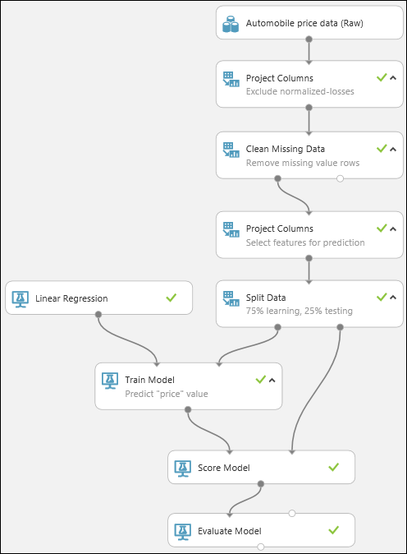
Part II First Experiment with Azure ML

Slide 16
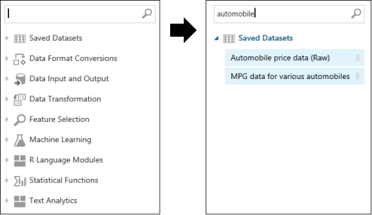
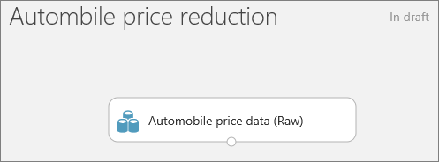
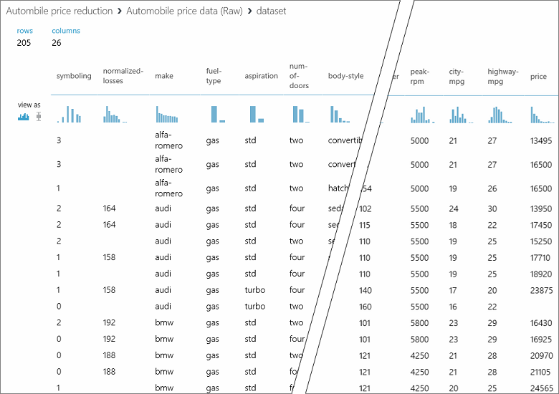
Part II First Experiment with Azure ML
Step 1. Get Data
Start a new experiments.
Type automobile in the search box.
Drag the dataset to the experiment canvas.
Check the data with Visualize.

Slide 17
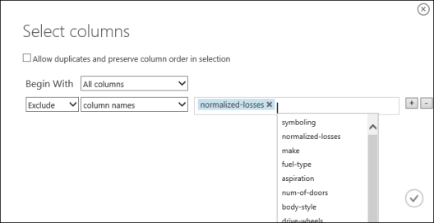
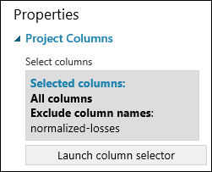
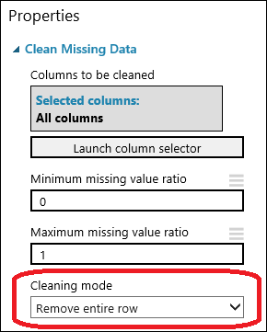
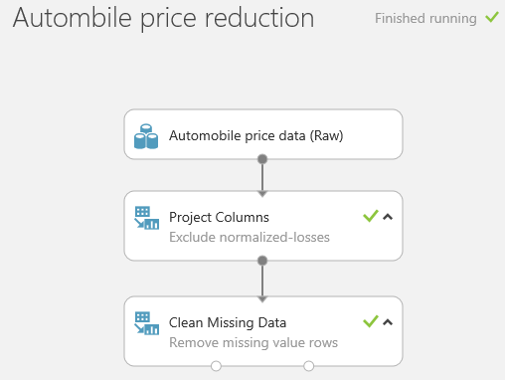
Part II First Experiment with Azure ML
Step 2. Preprocess Data
Type project columns.
Click Launch column selector. Select normalized-losses to remove.
Drag the Clean Missing Data. Select remove for missing row.

Slide 18
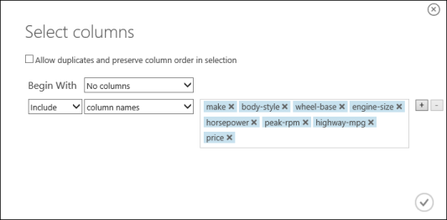
Part II First Experiment with Azure ML
Step 3. Define features
Drag Project Columns.
Launch column selector.
Select no columns for Begin with and then select include and column names.

Slide 19
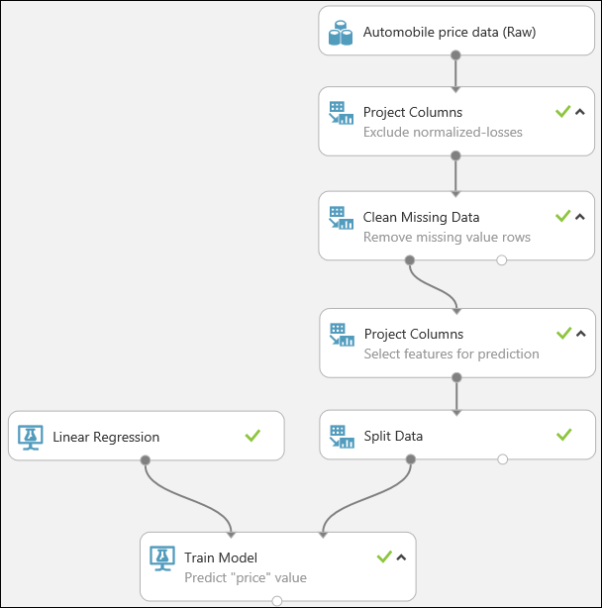
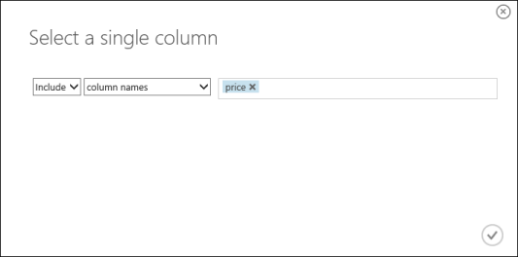
Part II First Experiment with Azure ML
Step 4. Choose and apply a learning algorithm
Split data (80:20).
Select learning algorithm (Linear Regression).
Select Train Model with price column.
Run the experiment.

Slide 20
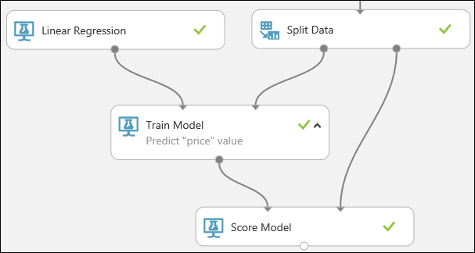
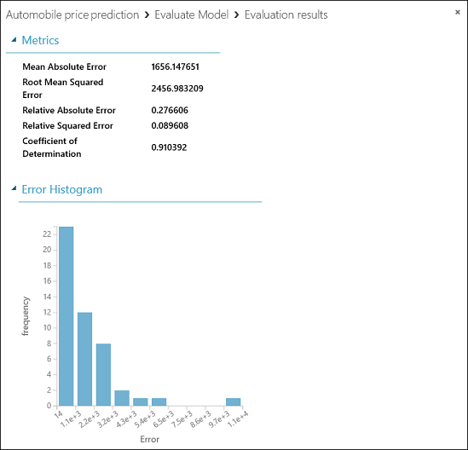
Part II First Experiment with Azure ML
Step 5. Predict new automobile prices
Find and drag Score Model.
Run the experiment.
Visualize Score Model.
Evaluate Model.

Slide 21
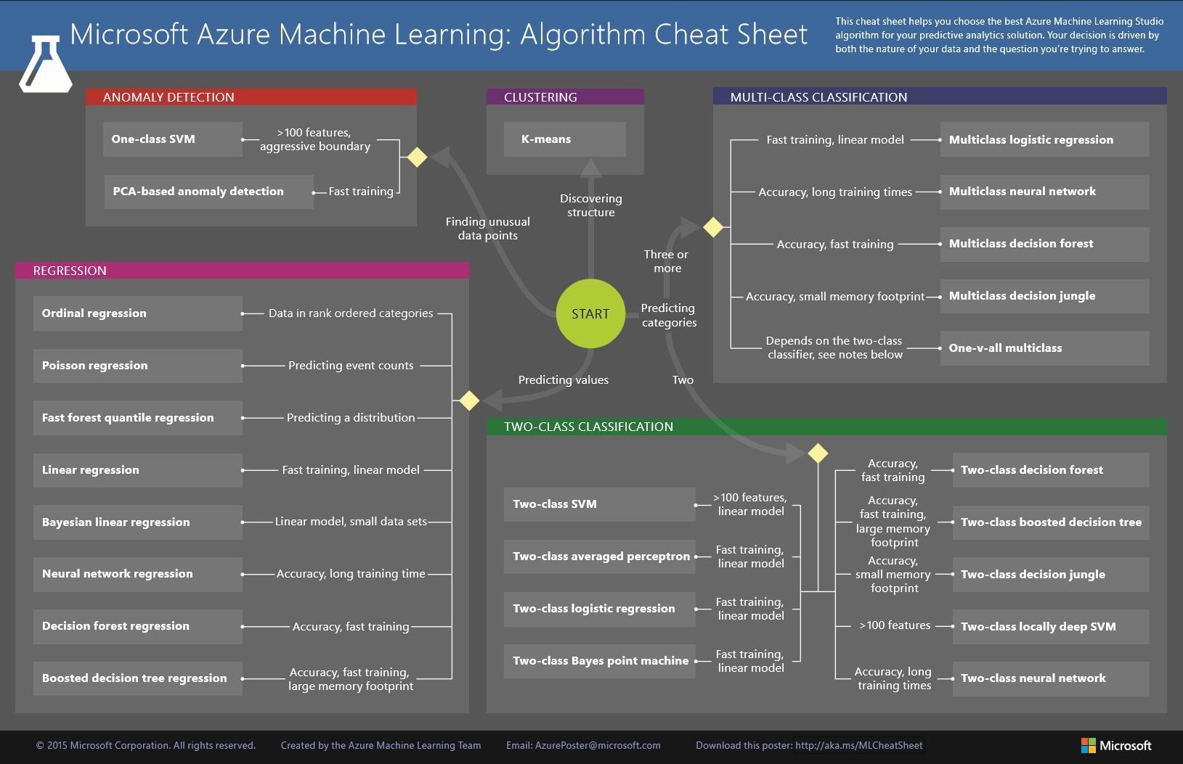
Part II Azure ML Algorithm Cheat Sheet

Slide 22
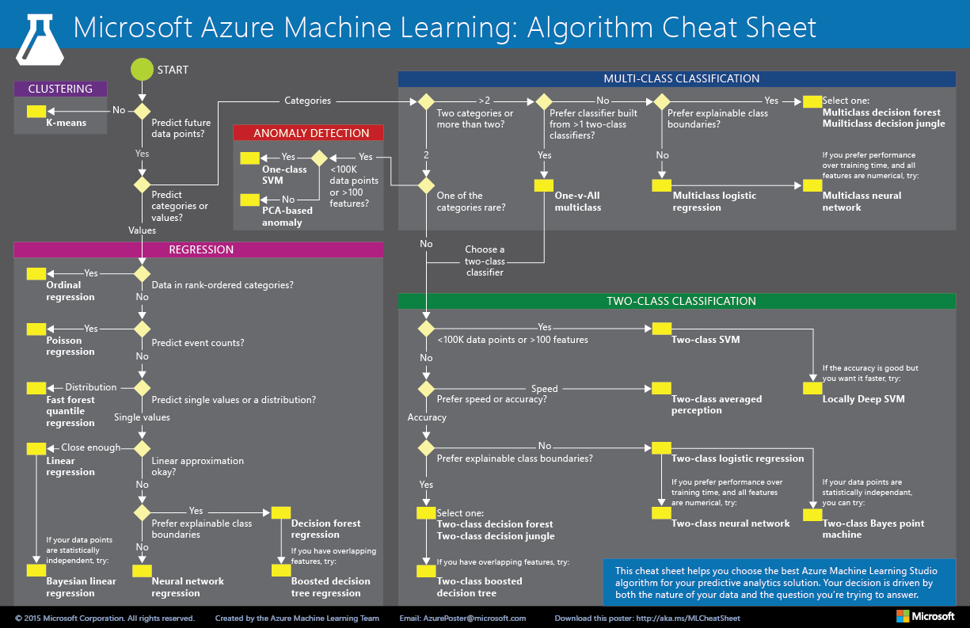
Part II Azure ML Algorithm Cheat Sheet

Slide 23
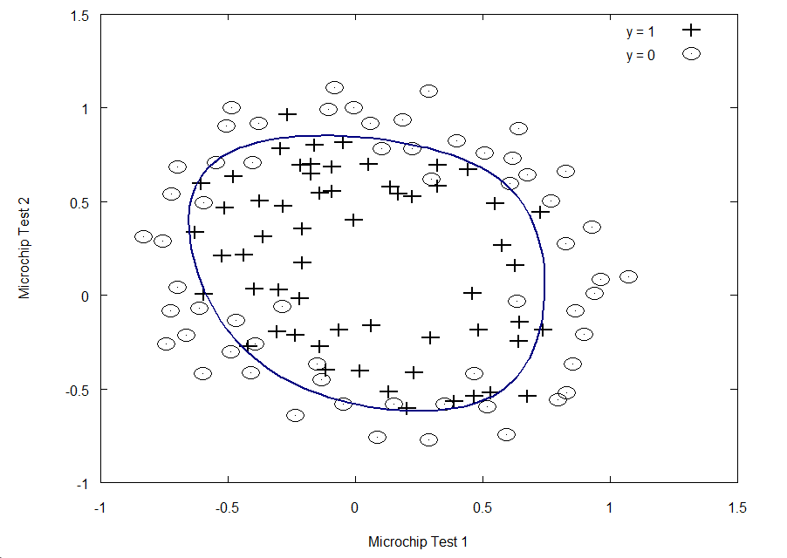
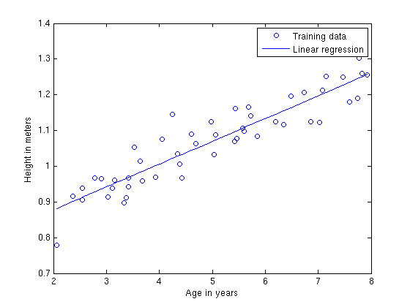
Part III Azure ML Hands-On: Classification
Supervised learning
Classification: used for predicting responses that can have just a few known values, such as “married,” “single,” or “divorced,” based on the other columns in the dataset.
Regression: predict one or more continuous variables, such as profit or loss, based on other columns in the dataset.
Simple linear regression: A single key variable is predicted based on one or more other variables in the dataset.
Multiple linear regression: More than one key variable is predicted based on one or more other variables in the dataset.
Multivariate linear regression: multiple correlated dependent key variables are predicted, rather than a single key variable.

Slide 24
Part III Azure ML Hands-On: Classification
Goal: To predict whether a person’s income exceeds $50,000 per year based on his demographics or census data.
Features:
Age, Workclass, Fnlwgt, Education, Education-num, Marital-status, Occupation, Relationship, Race, Sex, Capital-gain, Capital-loss, Hours-per-week, Native-country, Income.

Slide 25
Part III Azure ML Hands-On: Classification
Step 1: Get the data

Slide 26
Part III Azure ML Hands-On: Classification
Step 2: Visualize the data

Slide 27
Part III Azure ML Hands-On: Classification
Step 2: Visualize the data

Slide 28
Part III Azure ML Hands-On: Classification
Step 3: Split the data

Slide 29
Part III Azure ML Hands-On: Classification
Step 4: Train Model. Choose Two-Class Boosted Decision Tree. The income will be dependent.

Slide 30
Part III Azure ML Hands-On: Classification
Step 5: Score Model with Scored Labels and Probabilities.

Slide 31
Part III Azure ML Hands-On: Classification
Step 6: Evaluate Model. Check the ROC curve.

Slide 32
Part III Azure ML Hands-On: Classification
Step 7: Publish as a Web service.

Slide 33
Part III Azure ML Hands-On: Classification
Step 8: Test Web service.

Slide 34
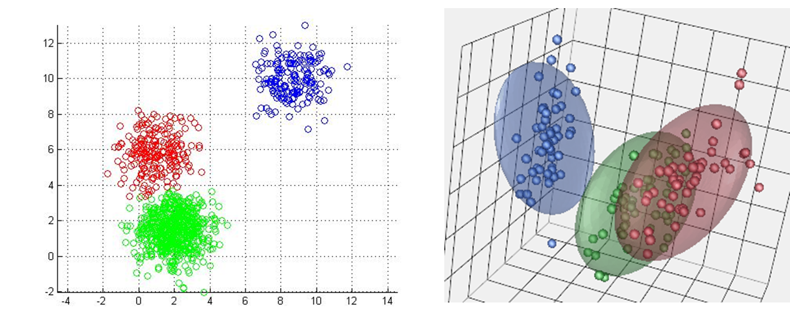
Part III Azure ML Hands-On: Clustering
K-Means Clustering module: The K-means method finds a specified number of clusters for a set of D-dimensional data points. It starts an initial set of K centroids, and then uses algorithms to iteratively refine the locations of the centroids. The algorithm terminates when the centroids stabilize or when a specified number of iterations are computed.
Train Clustering Model module: This module takes an untrained clustering model, such as that produced by the K-Means Clustering module, and an unlabeled data set. It returns a trained clustering model that can be passed to the Assign to Clusters module. It also returns labels for the training data.
Assign to Clusters module: This module takes a trained clustering model, produced by the Train Clustering Model module, and an unlabeled data set. The module then returns the cluster assignments (indexes) for the input data.

Slide 35
Part III Azure ML Hands-On: Grouping wholesale customers
Datasets
Wholesale customers dataset from the UCI Machine Learning Repository located at http://mlr.cs.umass.edu/ml/datasets/Wholesale+customers
It includes the annual spending on the following product categories
Channel: Retail channel types such as hotel/restaurant/café.
Region: Customer region code.
Fresh: Annual spending on fresh products.
Milk: Annual spending on milk products.
Grocery: Annual spending on grocery products.
Frozen: Annual spending on frozen products.
Detergents-Paper: Annual spending on detergents and paper products
Delicatessen: Annual spending on delicatessen products.

Slide 36
Part III Azure ML Hands-On: Grouping wholesale customers
Step 1: Get the data from URL and explore the data.

Slide 37
Part III Azure ML Hands-On: Grouping wholesale customers
Step 2: Choose the K-Means Clustering Model and Train the Clustering Model.

Slide 38
Part III Azure ML Hands-On: Grouping wholesale customers
Step 3: Setup the K-Means Clustering properties.
Euclidean: distance between two points is the length of line segment connecting them.
Cosine: Measure of similarity between two vectors of an inner space that measure the cosine of the angles between them.

Slide 39
Part III Azure ML Hands-On: Grouping wholesale customers
Step 4: Visualize the Training Results.

Slide 40
Part III Azure ML Hands-On: Grouping wholesale customers
Step 5: Split the data and set up for testing.

Slide 41
Part III Azure ML Hands-On: Grouping wholesale customers
Step 6: Publish as a Web Service.

Slide 42
Part III Azure ML Hands-On: Grouping wholesale customers
Step 7: Test the Web Service.

Slide 43
Part III Azure ML Hands-On: Recommendation
Create a model: A model is a container of your usage data, catalog data, and the recommendation model.
Import catalog data: This is an optional step. A catalog contains metadata information on the items, if you do not upload catalog data, the recommendation’s services will learn about your catalog from the usage data.
Import usage data
By uploading a file that contains the usage data.
By sending data acquisition events. Usually you upload a usage file to be able to create an initial recommendation model (bootstrap). You would use this usage until the system gathers enough data by using the data acquisition format.
Building a recommendation model:
This is an asynchronous operation in which the recommendation system takes all the usage data and creates a recommendation model. This operation can take several minutes or several hours depending on the size of the data and the build configuration parameters. When triggering the build, you will get a build ID. Use it to check when the build process has ended before starting to consume recommendations.

Slide 44
Part III Azure ML: Building the restaurant ratings recommender
Data sets
Restaurant features: This includes information about each restaurant, such as placeID, location, name, address, state, whether alcohol is served, smoking policy, dress code, accessibility, and price.
Restaurant customers: This includes a wide variety of personal attributes include userID, smoker, drink level, dress preference, marital status, birth year, interests, personality traits, religion, favorite color, weight, and budget.
Restaurant ratings: This includes key fields like userID, placeID, and rating.

Slide 45
Part III Azure ML: Building the restaurant ratings recommender
2. Select Columns
We can filter out unnecessary columns in the Restaurant Feature Data and Restaurant Customer Data datasets.
Restaurant features: placeID, latitude, longitude, price.
Customer Data: userID, latitude, longitude, interest, personality.
3. Split Module
Specify that half of this dataset is to be used for training and the other half of scoring the new recommendation model. We can filter out unnecessary columns in the Restaurant Feature Data and Restaurant Customer Data datasets.

Slide 46
Part III Azure ML: Building the restaurant ratings recommender
4. Train Matchbox Recommender module
Training dataset of user-item-rating triples: Ratings of items by users, expressed as a triple (Use, Item, Rating).
Training dataset of user features: Dataset containing features that describe users.
Training dataset of item features: Dataset containing features that describe items.

Slide 47
Part III Azure ML: Building the restaurant ratings recommender
5. Score Matchbox
Trained Matchbox recommender.
Dataset to score.
User features: Dataset containing features that describe users.
Item features: Dataset containing features that describe items.

Slide 48
Part III Azure ML: Building the restaurant ratings recommender
5. Score Matchbox
Rating Prediction: Predict the rating that a customer will give a particular restaurant.
Item Recommendation: Predict which restaurants will be most highly rated by the user.
Related Users: Predict which customers (users) are most like this customer.
Related Items: Predict which restaurants (items) are most like this restaurant.

Slide 49
Part III Azure ML: Building the restaurant ratings recommender
5. Evaluate Recommender

Slide 50
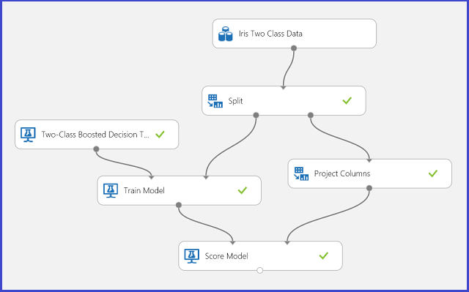
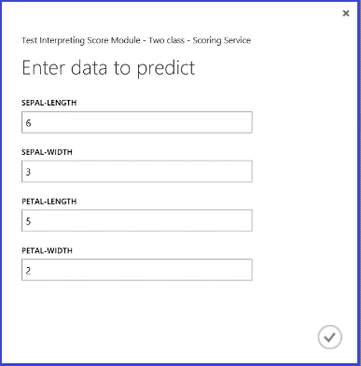
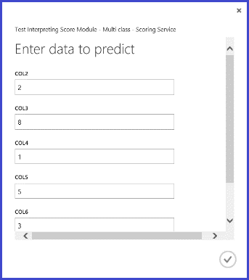
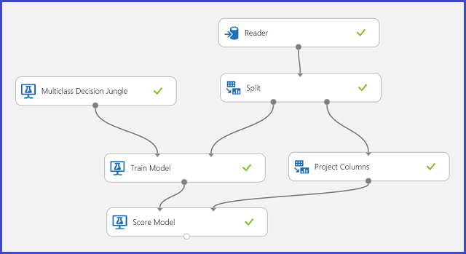
Part III Azure ML Exercises: Classification
Two-class classification
To classify Iris flowers based on their features.
Two flower species (classes 0 and 1).
Four features for each flower (sepal length, sepal width, petal length, and petal width)
Multi-class classification
To classify a letter (class), given some attribute values extracted from the hand-written letter images.
Twenty-six letters form twenty-six classes.

Slide 51
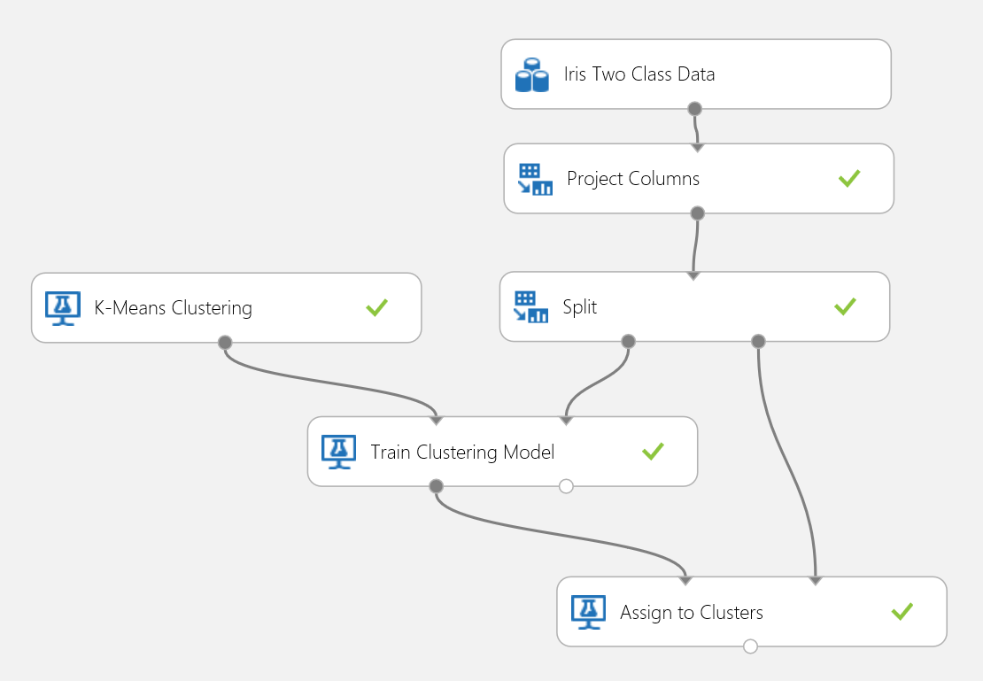
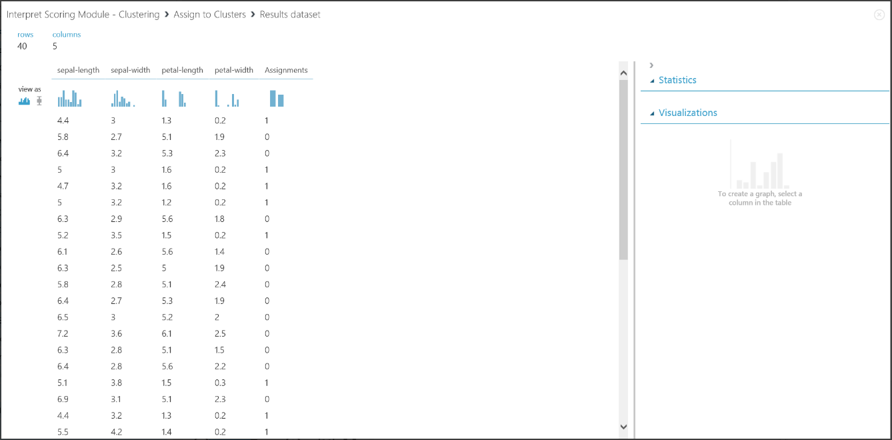
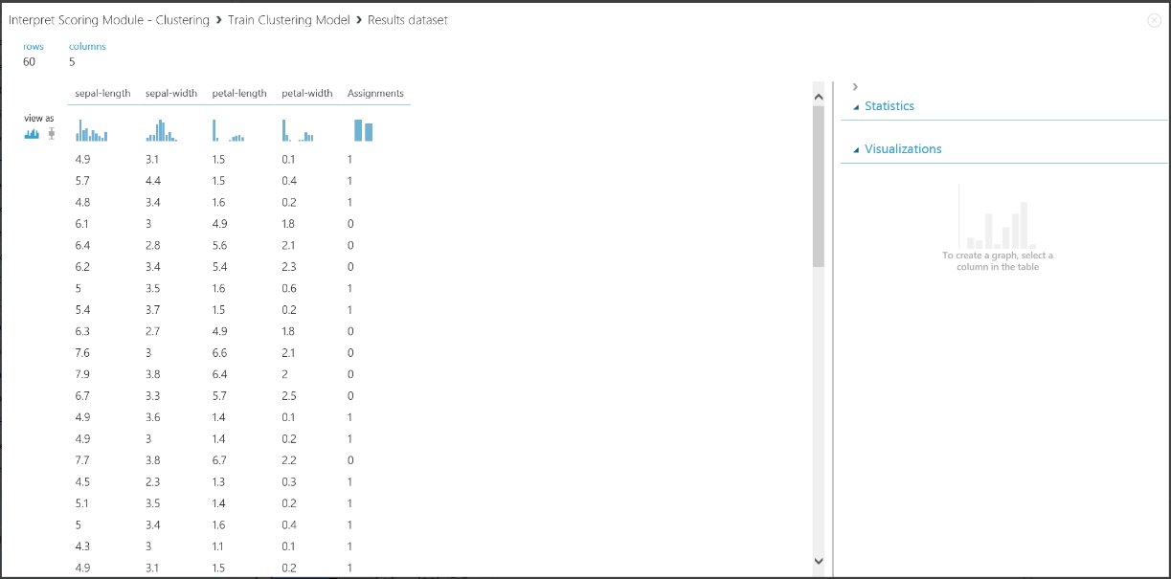
Part III Azure ML Exercises: Clustering
Clustering differs from classification in that the training dataset does not have ground-truth labels by itself.
Group the training dataset instances into distinct clusters.
During the training process, the model labels the entries by leaning the differences between their features.

Slide 52
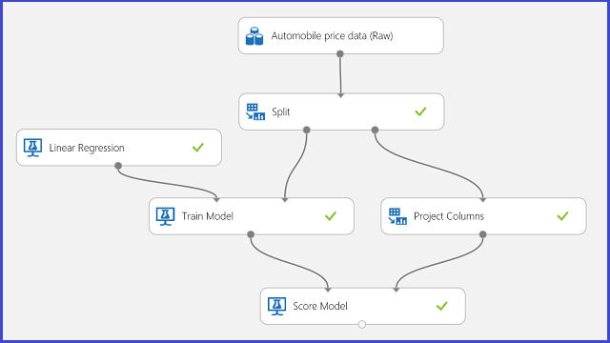
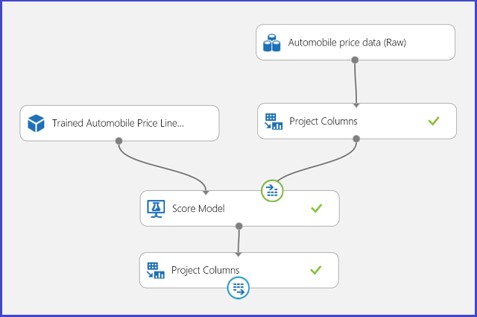
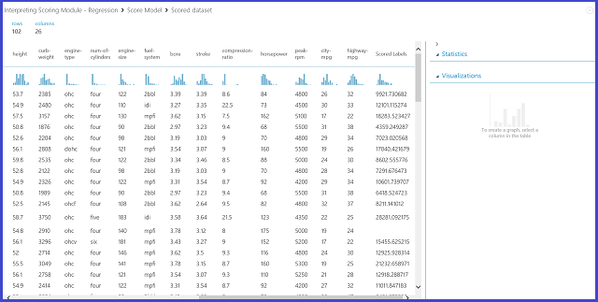
Part III Azure ML Exercises: Regression
To predict the price of a car based on its features including make, fuel type, body type, drive wheel, etc.

Slide 53
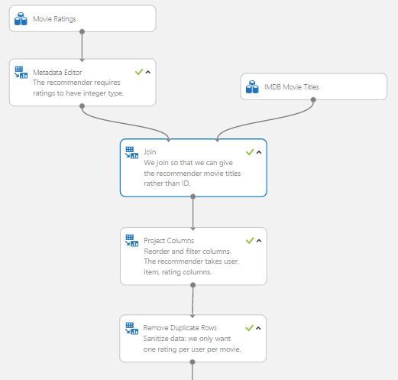
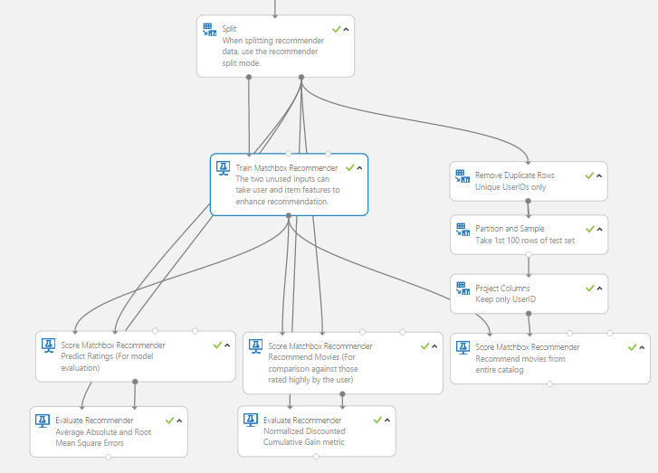
Part III Azure ML Exercises: Recommendation

Slide 54
Part IV Lessons and Resources
Data wrangling is important
More time is spent on data wrangling than model building.
Different sources, formats, schemas, missing values and noisy data.
Data manipulation modules are very popular: Execute R script, SQL Transform, etc.
Azure ML Modeling
Modeling depends on the Business Application Domain and Data.
Feature Engineering is essential.
Parameter Tuning is needed.
Learn R or Python Script.
Resources
Getting Started: https://studio.azureml.net
Gallery: http://gallery.azureml.net/
Site/ML Studio/Docs: http://azure.microsoft.com/en-us/services/machine-learning/
Blog: http://blogs.technet.com/b/machinelearning/
edX: Microsoft DAT203X Data Science and Machine Learning Essentials https://courses.edx.org/courses/course-v1:Microsoft+DAT203x+3T2015/info
Microsoft Virtual Academy: https://mva.microsoft.com/

Slide 55

Q and A

